Slide 1

8th Grade Math: Pre-Algebra
Unit 9, Lesson 6 Describing Rigid Transformations Volume 2, pg. 87

Slide 2


Benchmarks
MA.8.GR.2.1
Given a preimage and image generated by a single transformation, identify the transformation that describes the relationship.
MA.8.GR.2.3
Describe and apply the effect of a single transformation on two-dimensional figures using coordinates and the coordinate plane.
volume 2, pg. 87

Slide 3
Integrated Mathematical Thinking and Reasoning Standards
MA.K12.MTR.1.1 Actively participate in effortful learning both individually and collectively.
MA.K12.MTR.2.1 Demonstrate understanding by representing problems in multiple ways.
MA.K12.MTR.4.1 Engage in discussions that reflect on the mathematical thinking of self and others.
volume 2, pg. 87

Slide 4

Learning Targets
I can describe the effect of a single transformation.
I can describe the effect of a transformation on the coordinate plane.
volume 2, pg. 87

Slide 5

Warm-Up
volume 2, pg. 88

Slide 6

9.6.1 Warm-Up: Eight-Digit Puzzle
Place the numbers $1$ through $8$ in the rectangles below so that no two consecutive numbers are next to each other horizontally, vertically, or diagonally.
volume 2, pg. 88

Slide 7

Collaboration
volume 2, pg. 88

Slide 8

9.6.2 Collaboration: Transformation Matching Cards
Work with your partner to match the transformation cards with the descriptions of the transformations. Record your matches in the table using the letter shown on the cards.
Transformation Card | Description Card
1
2
3
4
5
6
7
8
volume 2, pg. 88

Slide 9
Write a brief summary of what you noticed about the location and orientation of the image in comparison to the preimage for each type of transformation.
Transformation | Location | Orientation
Translation
Reflection
Rotation
volume 2, pg. 88

Slide 10
Nigel and Elena are discussing what single transformation took place to map $∆BNL$ to $∆PWK$.
volume 2, pg. 89

Slide 11
Nigel claims that the transformation is a rotation about the origin. Elena says the transformation is a reflection. Which student do you agree with?
If you agree with Nigel, what is the angle of rotation and direction? If you agree with Elena, what is the line of reflection?
volume 2, pg. 89

Slide 12

Guided Practice
volume 2, pg. 89

Slide 13

9.6.3 Guided Practice: Describing Transformations
On the coordinate grid shown, $∆ZCM$ is the preimage, and $∆PFS$ is the image after a single transformation.
volume 2, pg. 89

Slide 14
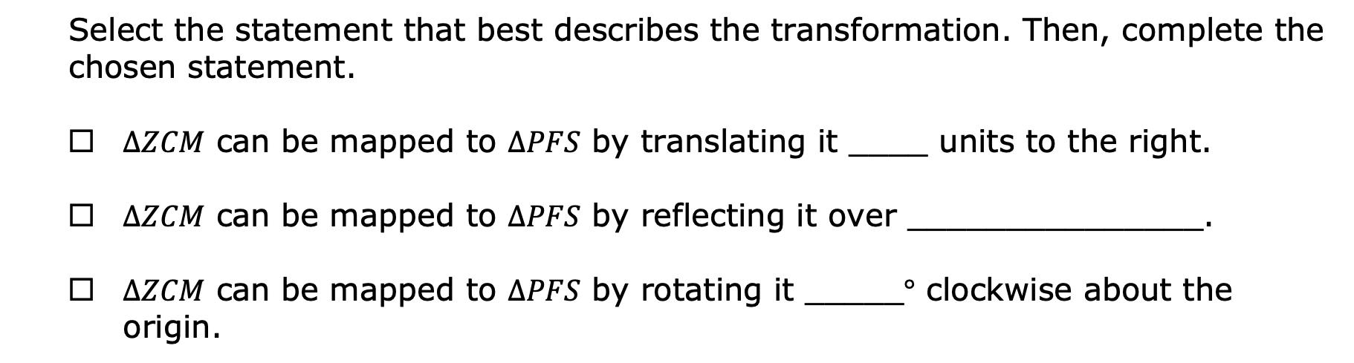
Select the statement that best describes the transformation. Then, complete the chosen statement.
$∆ZCM$ can be mapped to $∆PFS$ by translating it ____ units to the right.
$∆ZCM$ can be mapped to $∆PFS$ by reflecting it over _______________.
$∆ZCM$ can be mapped to $∆PFS$ by rotating it _____$°$ clockwise about the origin.
volume 2, pg. 89

Slide 15

When describing a transformation on the coordinate plane, the description should include the type of transformation as well as the following information.
Translation: the direction and number of units moved
Rotation about the origin: the angle and direction of the rotation
Reflection: the line of reflection
volume 2, pg. 90

Slide 16
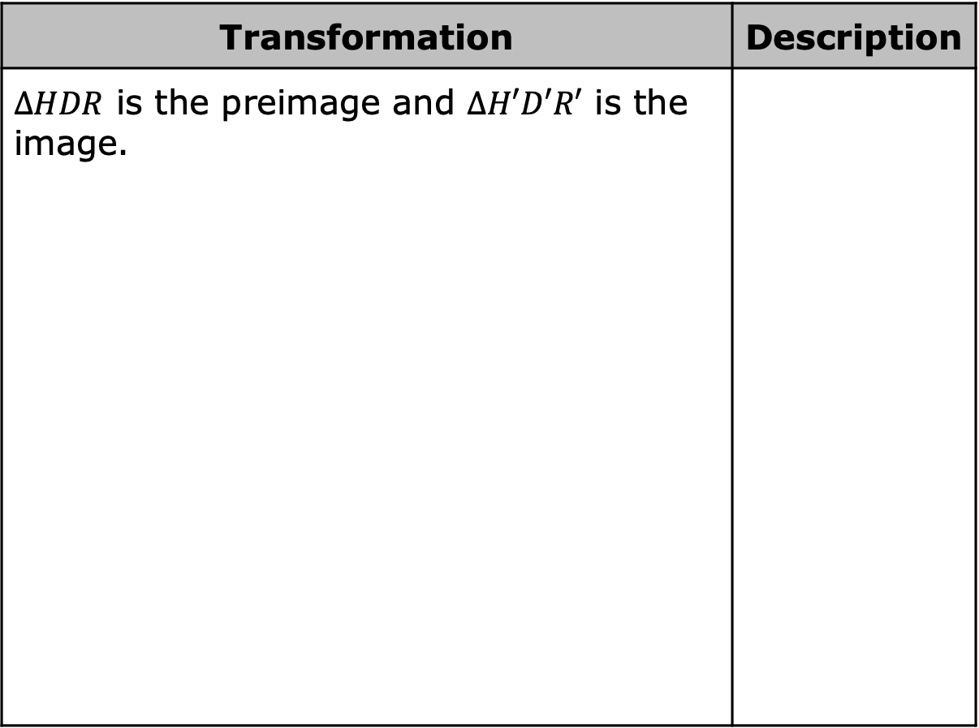
Describe each transformation shown.
Transformation | Description
$∆HDR$ is the preimage and $∆H′D′R′$ is the image.
volume 2, pg. 90

Slide 17
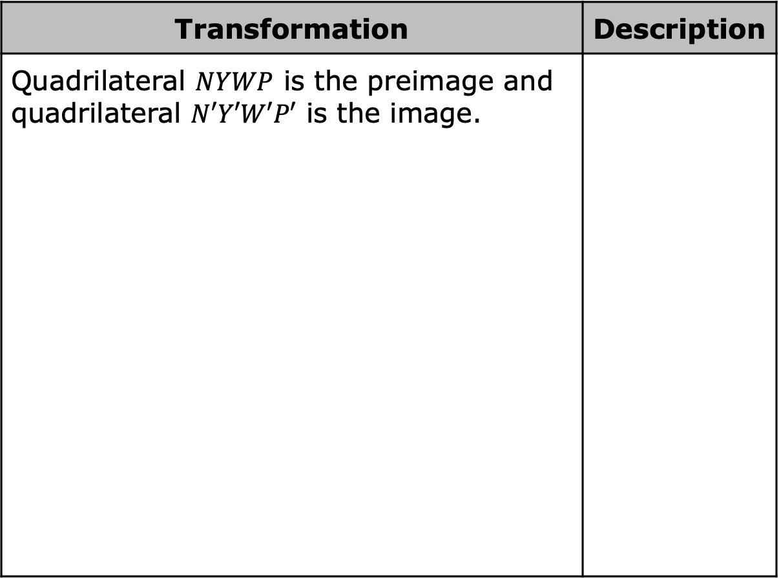
Transformation | Description
Quadrilateral $NYWP$ is the preimage and quadrilateral $N′Y′W′P′$ is the image.
volume 2, pg. 90

Slide 18

Your Turn
volume 2, pg. 91

Slide 19
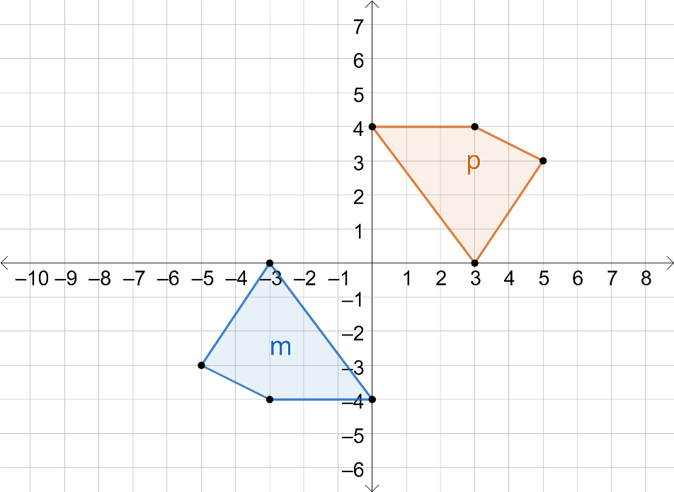
9.6.4 Your Turn!
On the coordinate grid, figure $p$ is the result of a transformation on figure $m$.
volume 2, pg. 91

Slide 20
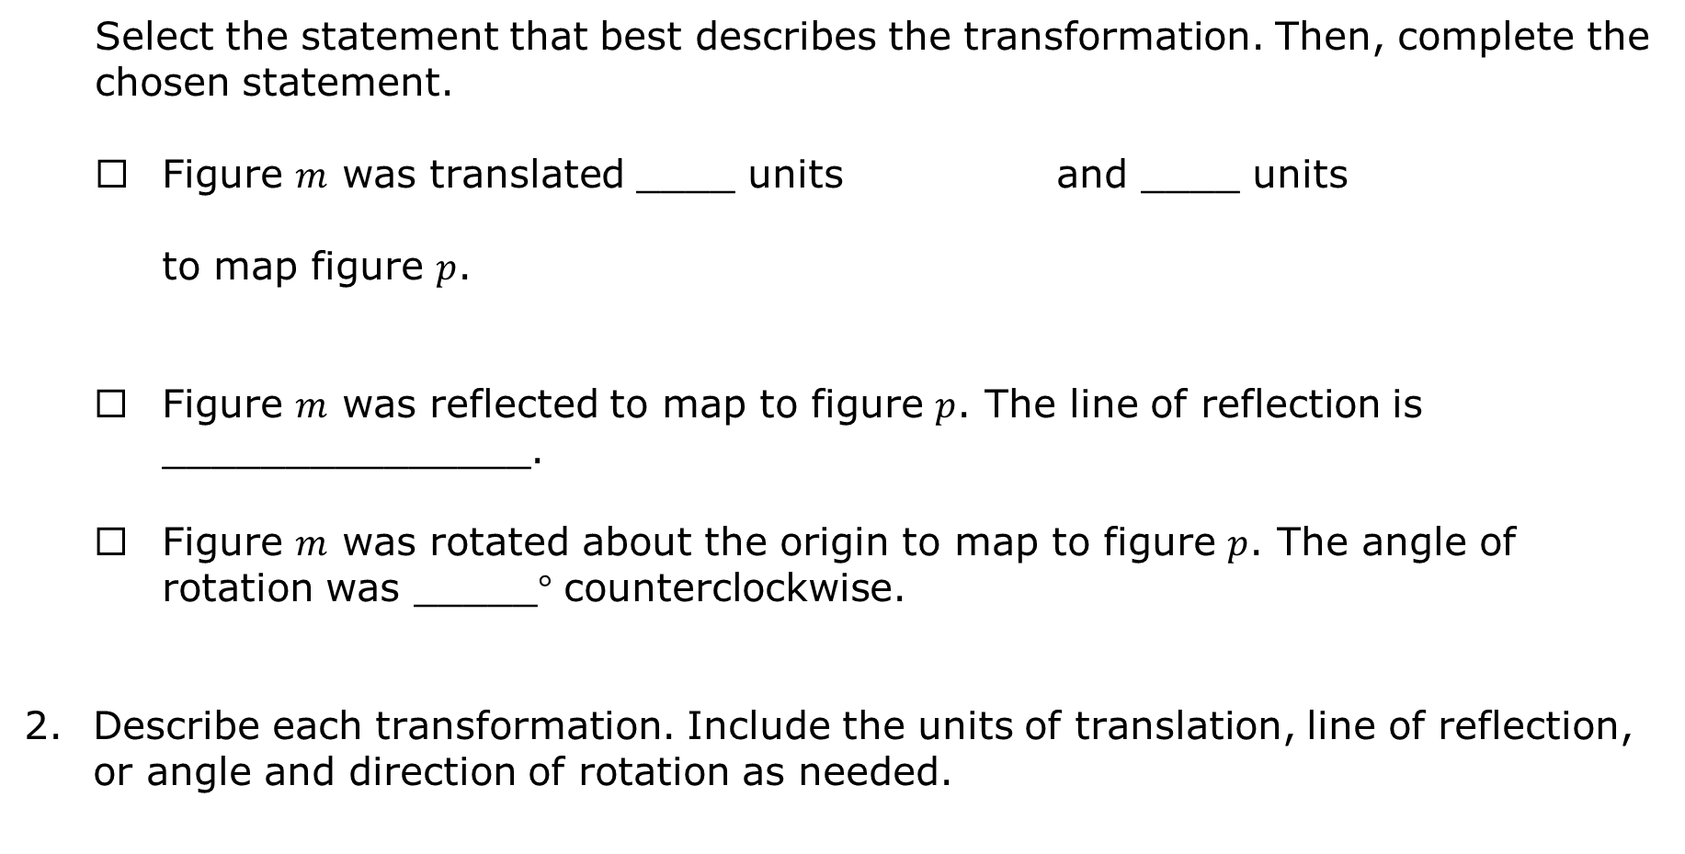
Select the statement that best describes the transformation. Then, complete the chosen statement.
Figure $m$ was translated ____ units and ____ units
to map figure $p$.
Figure $m$ was reflected to map to figure $p$. The line of reflection is _______________.
Figure $m$ was rotated about the origin to map to figure $p$. The angle of rotation was _____$°$ counterclockwise.
Describe each transformation. Include the units of translation, line of reflection, or angle and direction of rotation as needed.
right
left
up
down
volume 2, pg. 91

Slide 21
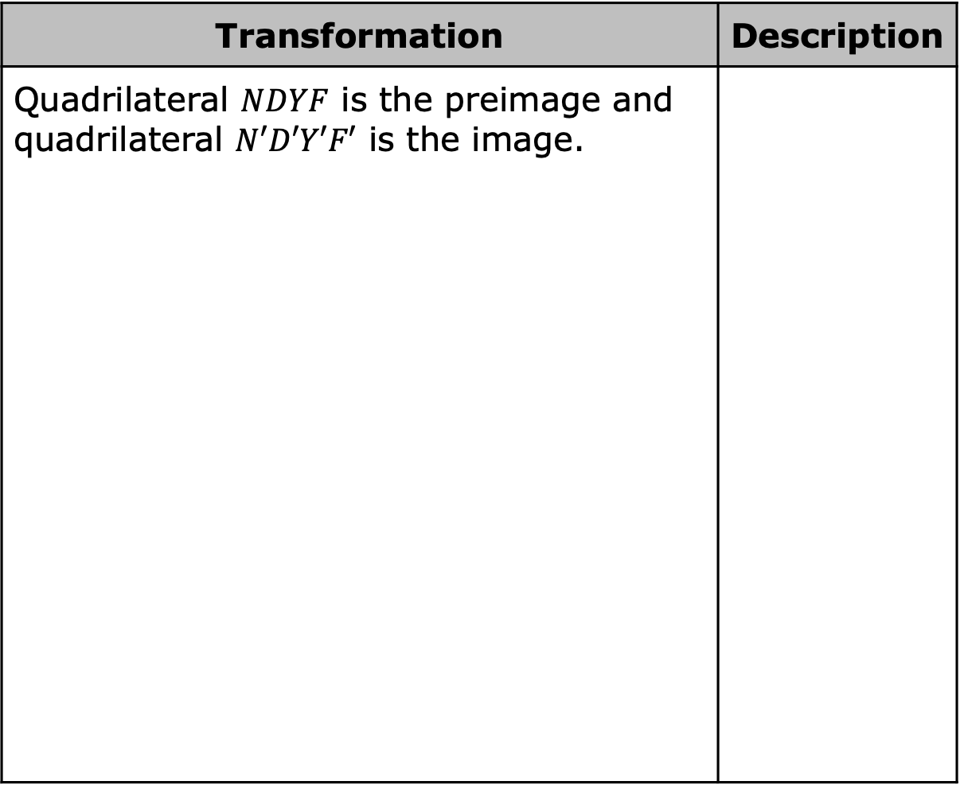
Transformation | Description
Quadrilateral $NDYF$ is the preimage and quadrilateral $N′D′Y′F′$ is the image.
volume 2, pg. 91

Slide 22

Transformation | Description
Quadrilateral $VMCX$ is the preimage and quadrilateral $V′M′C′X′$ is the image.
volume 2, pg. 91

Slide 23

Wrap-Up
volume 2, pg. 92

Slide 24
9.6.5 Wrap-Up: Ticket Out the Door
1. $∆MTR$, the preimage, and $∆M′T′R′$, the image, are shown on the coordinate plane.
volume 2, pg. 92

Slide 25
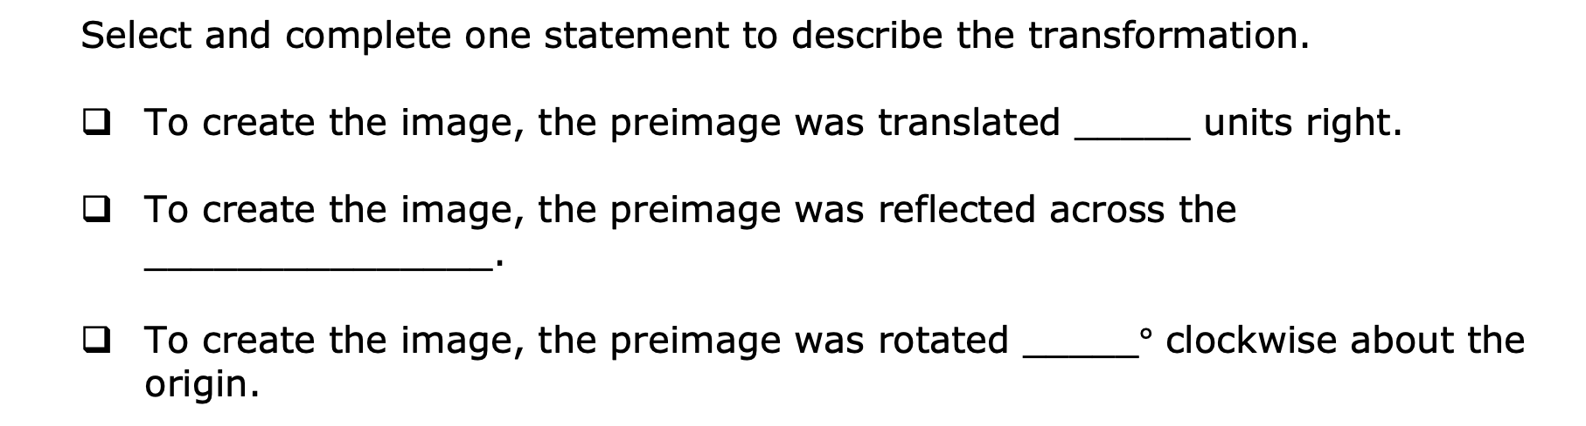
Select and complete one statement to describe the transformation.
To create the image, the preimage was translated _____ units right.
To create the image, the preimage was reflected across the _______________.
To create the image, the preimage was rotated _____$°$ clockwise about the origin.
volume 2, pg. 92

